Slide 1
Web Programming Project: Online Bookshop Mlinaric Katsiaryna
Children books
Education books
Travel books

Slide 2
Languages and libraries:
HTML, CSS, HTML5: forms validation
PHP :work with functions, readind&writing XML files, using of global variables and superglobal variables($_SESSION, $_POST, $_GET), using of Date/Time class, using of multipages, using of mail() PHP function, classes and objects
JavaScript: forms validation, events handling
JQuery
AJAX: using the XMLHttpRequest object
MySQL

Slide 3
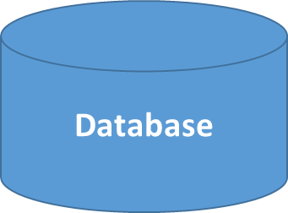
Saving of data:
Products
Orders
Clients
users.xml
Login-password
logins.xml
Comments
comments.xml

Slide 4
MySQL tables:
clients: Id, username, Fiestname, Lastname, email
books: Id, Title, Author, Price, Amount, CatalogNr
orders: Id, groupId, BookId, ClientId
catalogs: catalogId, catalogName

